Slide 1
COMP1003 – Algorithms, Data Structures & Mathematics Lecture Linked Lists
Thomas Wennekers
University of Plymouth

Slide 2
Main Idea
Collections of data can be held in compound items (e.g., arrays) or as linked sets of items
Linked lists are the simplest case of linked structures; they arrange items in linear order
They can be used to implement dynamic stacks and queues
[they are a common topic in job interviews]

Slide 3
Aims and Objectives
to review addresses, pointers and references
to introduce the linked list ADT
to implement basic operations on linked list like traversal, or insertion and deletion of items
to implement stacks & queues using linked lists

Slide 4
Outline
Arrays versus Linked List
Review addresses, pointers, references
Operations on linked lists, like:
traversal, isEmpty, size
insert item at front or end
remove item at front or end, or anywhere
Linked stack and queue
Run-time complexity

Slide 5
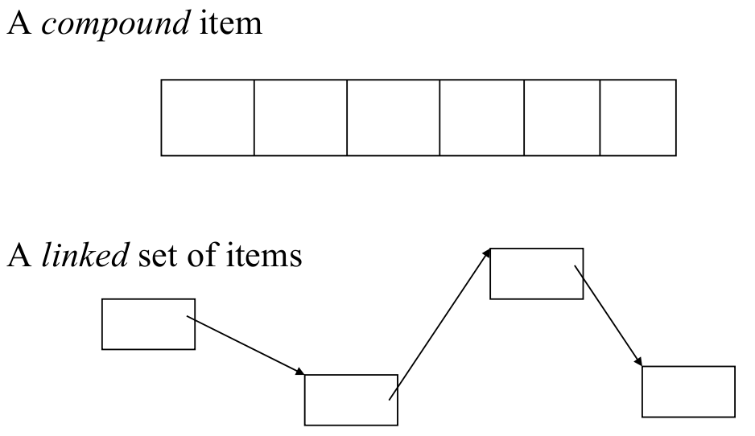
Array versus Linked List
A collection of Items can be hold as:

Slide 6
Arrays versus Linked Lists
Standard Arrays have a fixed size
If an array runs out of space, it has to be reallocated and possibly copied; this costs time
If an array is allocated too large it wastes space
A linked list dynamically allocates and frees its space; it can grow and shrink; data is not copied
The time used to get (and free?) the memory space is more homogeneously distributed
Insertion in the middle: arrays O(N)/ Lists O(1)

Slide 7
Linked Lists are implemented
using
addresses & pointers, or references

Slide 8
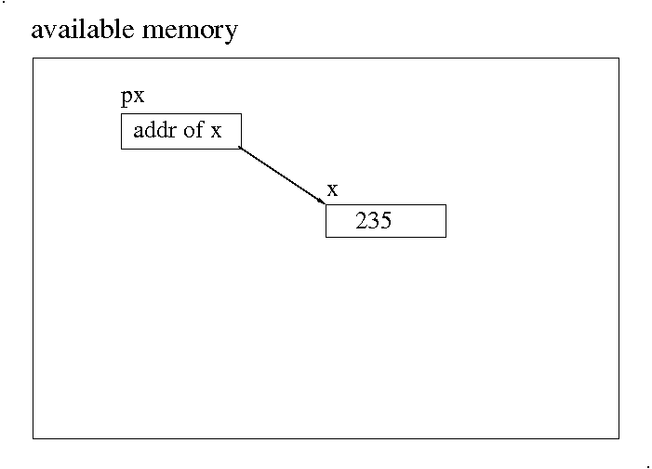
Reference and Value-Types
x holds a value px holds a reference

Slide 9
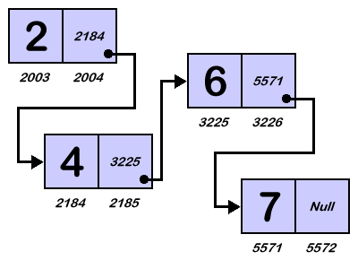
Linked List (of integers) in Memory
Note: Large numbers are the data items,
small numbers addresses/references

Slide 10
Linked List (of integers) in Memory
Note: Null, NULL, NIL, or similar refers to “end of queue” or “undefined address”; null can be used in C# code, e.g. for comparison (see later).

Slide 11



Various Linked Structures
Collections of items with different structure: tree, linear list, graph

Slide 12
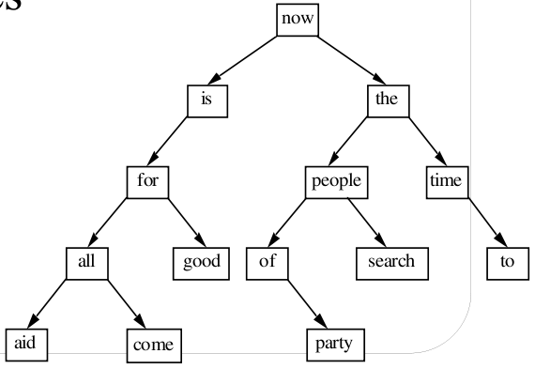
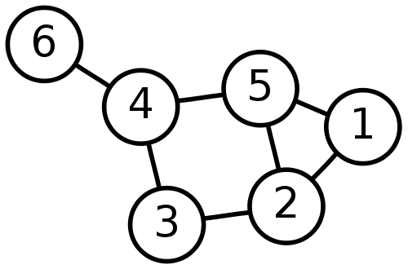
Abstraction from Item Type
Lists, trees and graphs can hold any data type (including records, trees, graphs …)
They can conveniently be stored on computers using linked structures (later lectures)

Slide 13
Abstract linked list functionality

Slide 14
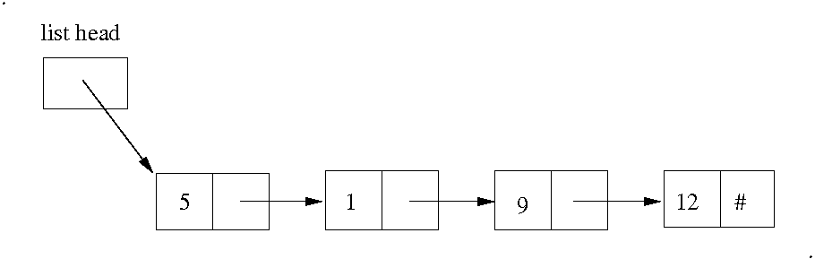
Linked List ADT
Type of data can be arbitrary; here: integers

Slide 15
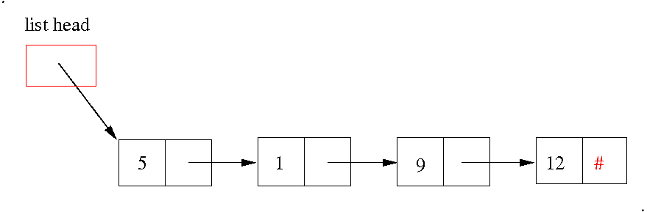
Linked List ADT
# means null, nil, NULL, 0
the list head is different from the nodes

Slide 16
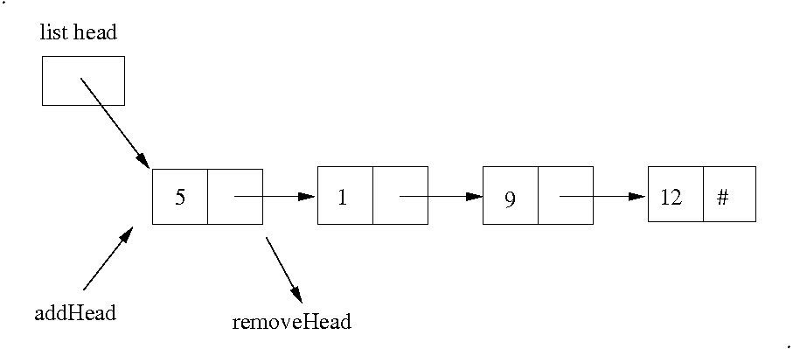
Operations at List Head

Slide 17
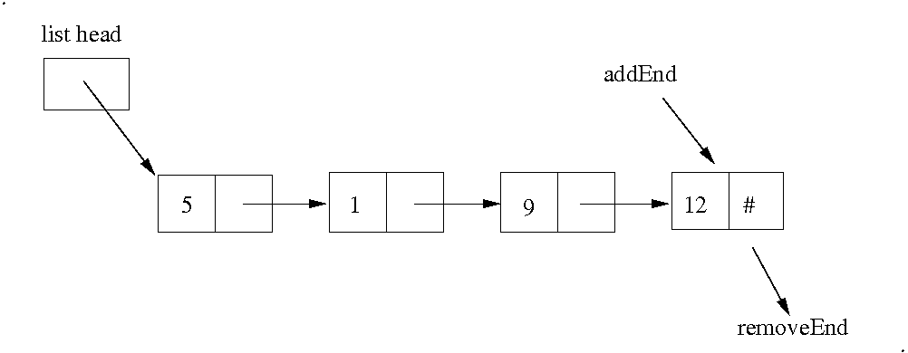
Operations at List End

Slide 18
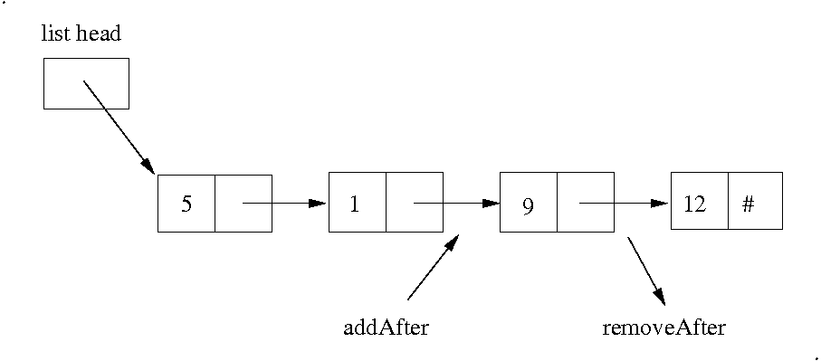
Want to Add/Remove anywhere?

Slide 19
Other Possibly Useful Functionality
isEmpty
first/peek/top; last?
length
traversal
search
print, save
min, max, sum …
sort
...

Slide 20
A concrete linked list implementation

Slide 21
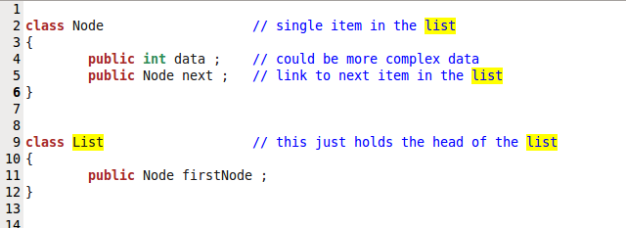
Node and List Declaration
Note: The Node definition is recursive; → can do node.next.next.next …

Slide 22
Node and List Declaration
Note: typically the structures are more complex: data records; list-length variable, last element, ...

Slide 23
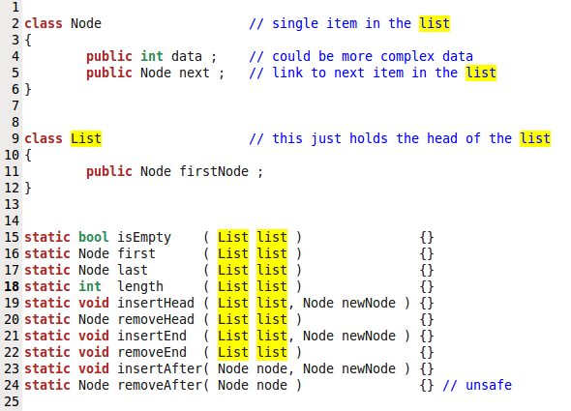
Linked List “Interface” (The implementation will usually be hidden)

Slide 24
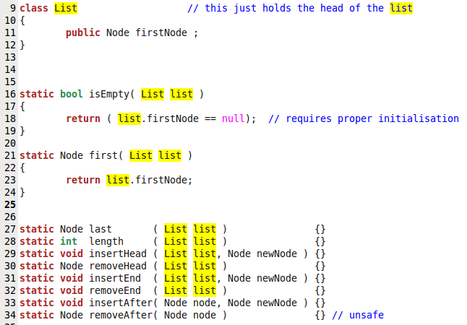
“isEmpty” and “first” are simple

Slide 25
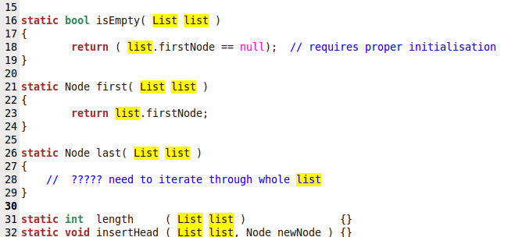
The last node is more difficult to get

Slide 26
List Traversal or “Scanning”
go through the list starting from the head-node
do whatever has to be done with each node
(nothing if we just want to go to the last node)
finish, when the node is the last one
(in which case its next-pointer is null,nil,#)

Slide 27
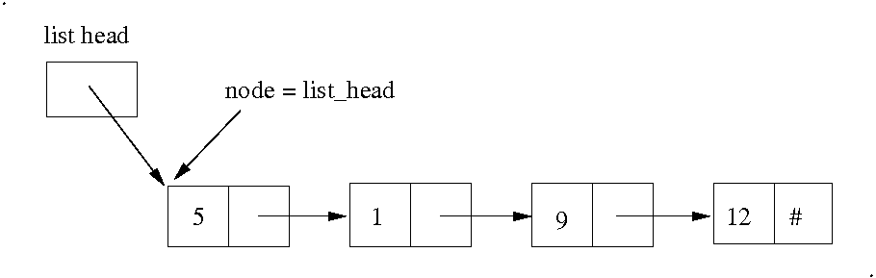
Traversal – Initialistation
Node “node” is a helper variable that helps scanning through the list

Slide 28
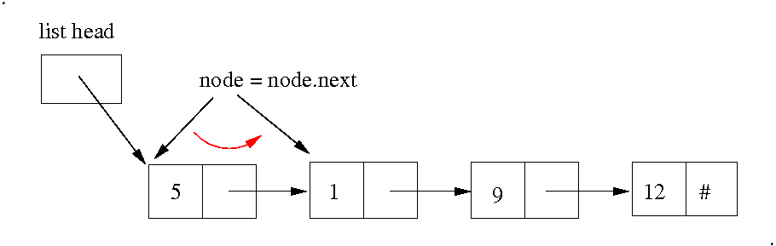
Traversal – first step
node = node.next finds the reference of the next node, which can then be accessed by node again

Slide 29
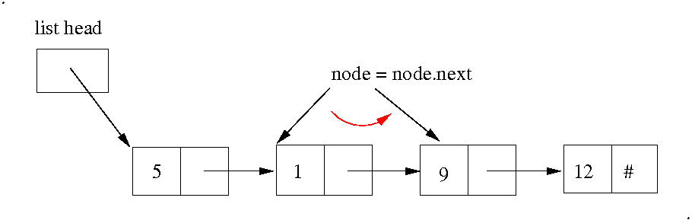
Traversal – next step
Nothing new:
node = node.next again finds the next node

Slide 30
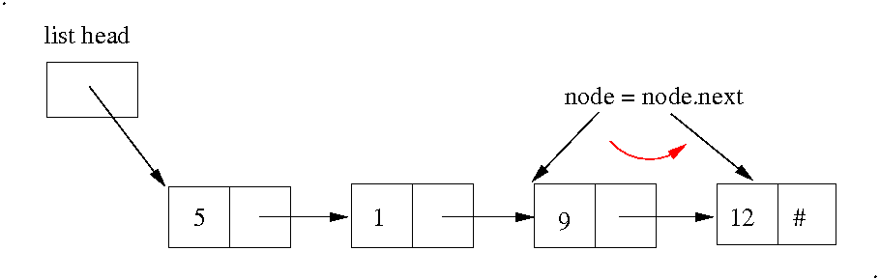
Traversal – next step
node = next.node finds the last node (which can be tested with “node.next==null”

Slide 31
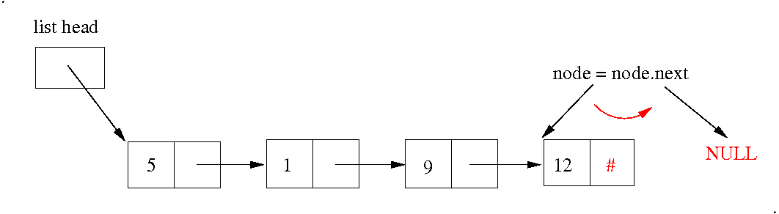
Traversal – finish
node = node.next now sets “node” to null, which can be used to break out of the iteration

Slide 32
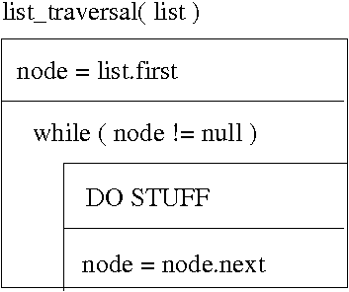
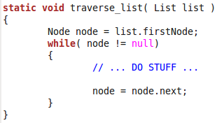
General List Traversal – Structogram and Code
Note that the “node=node.next” comes at the end
after STUFF is done with node

Slide 33
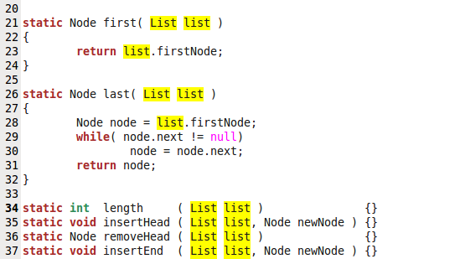
first- and last-Functions

Slide 34

Last Node – a “better” Solution
One can add a “Node last” entry in the List class that always points to the last node
This requires proper updating of the new last-entry
and would slow down operations somewhat

Slide 35
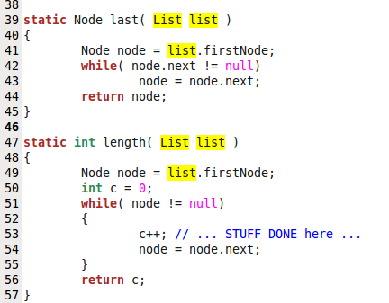
Length works similar to last()

Slide 36
Notes about scanning
We should check the list in “last” is not empty
A Length variable in the list class makes more sense → Complexity
Can do other things with the nodes:
print, display or save data
search for a data item
compute minimum or maximum ...
… or do any other computations

Slide 37
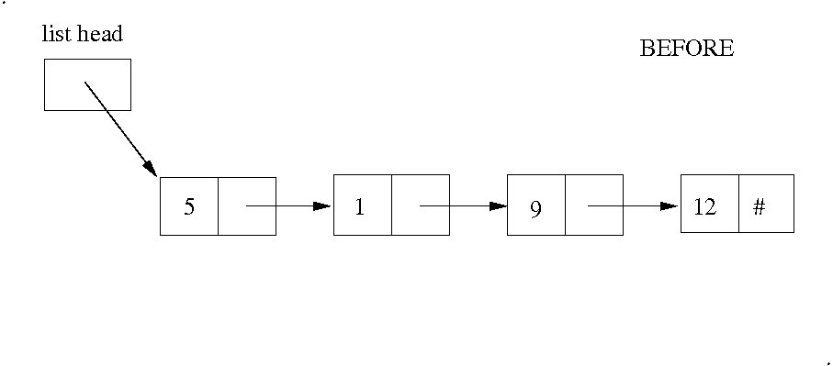
List Maintenance – Adding at Head

Slide 38
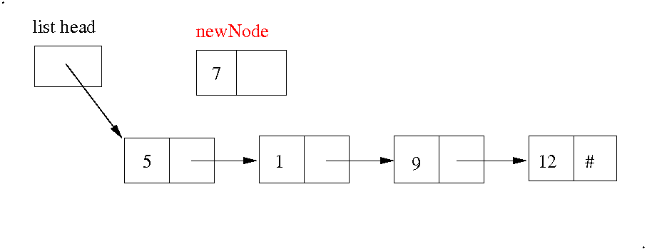
Adding a new Node at List Head

Slide 39
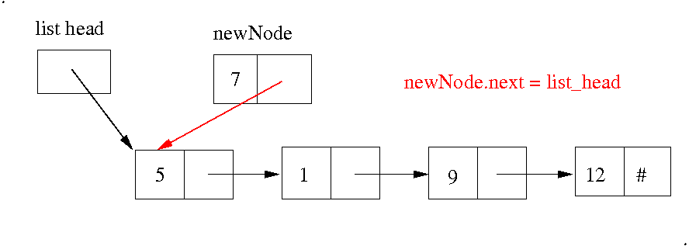
Adding at List Head

Slide 40
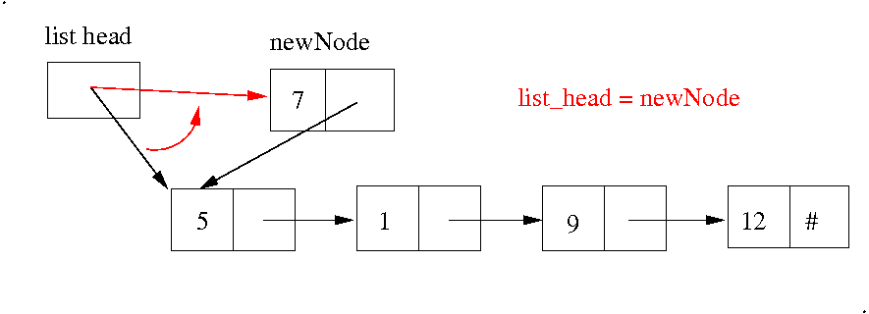
Adding at List Head
Note that this step MUST come after the previous one, which needs the old list head.

Slide 41
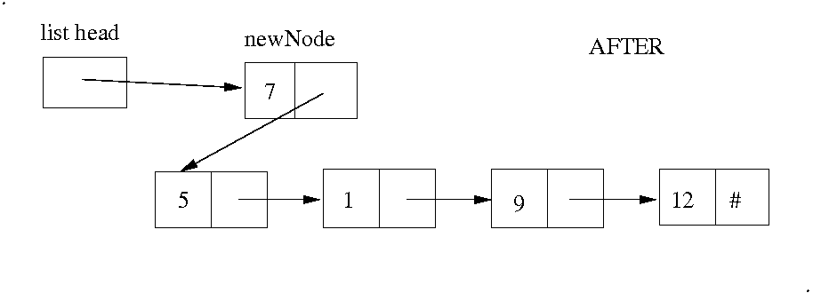
Adding at List Head

Slide 42

Adding at List Head
list.firstNode can be null (meaning an empty list)
should check that list and newNode are not null

Slide 43
Remove/Delete/Pop Head
Warning: Don't loose the reference to the 5-node

Slide 44
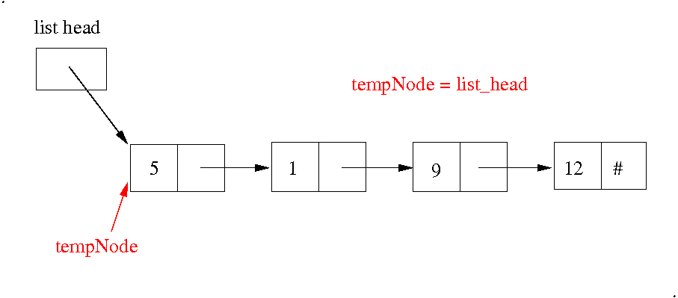
Remove/Delete/Pop Head
Save a reference to the head element

Slide 45
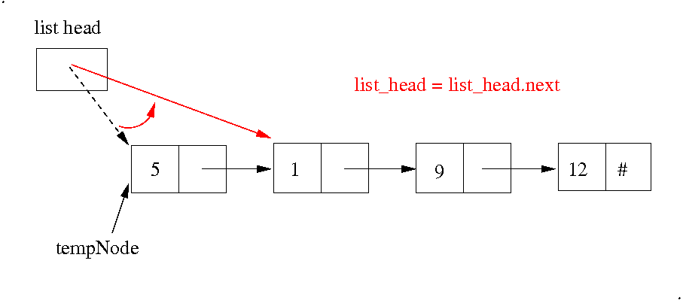
Remove/Delete/Pop Head
Advance the head to the next element

Slide 46
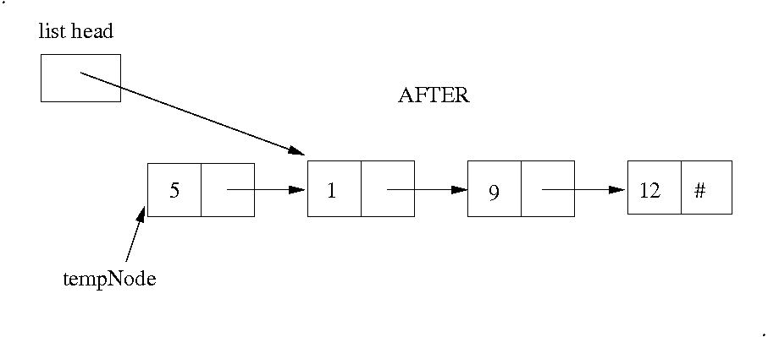
Remove/Delete/Pop Head
tempNode can be further processed or returned or just left to the garbage collection

Slide 47
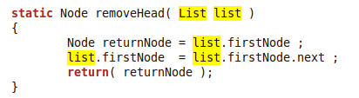
Remove/Delete/Pop Head – Preliminary Version
“Remove()” or “Delete()” may not return the element in which case returnNode is not required
This code is unsafe: as the list could be empty (can do check inside or outside; efficiency?)

Slide 48
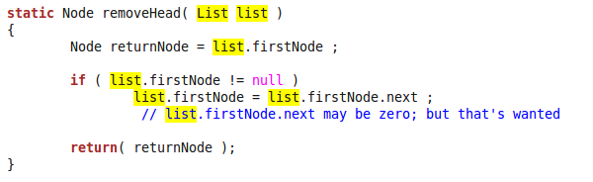
Remove/Delete/Pop Head – Improved Version
if list.firstNode.next is null; list.firstNode is correctly set to null indicating an empty list
“list” itself could still be null; that however would not be too difficult to avoid

Slide 49
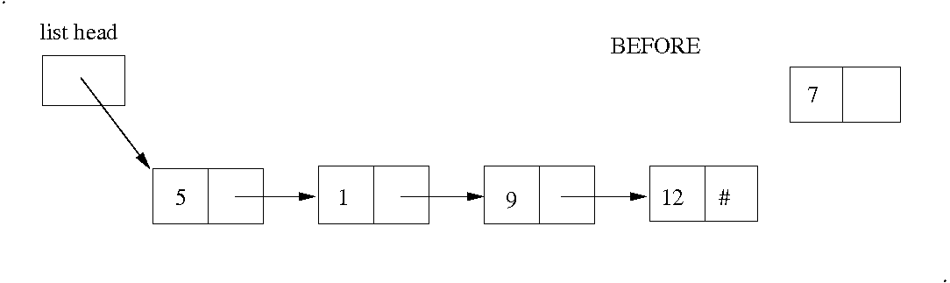
Insertion at End of List
just add a link from last to new node??
not quite .. we have no reference of the last node
→ need to iterate to the end

Slide 50
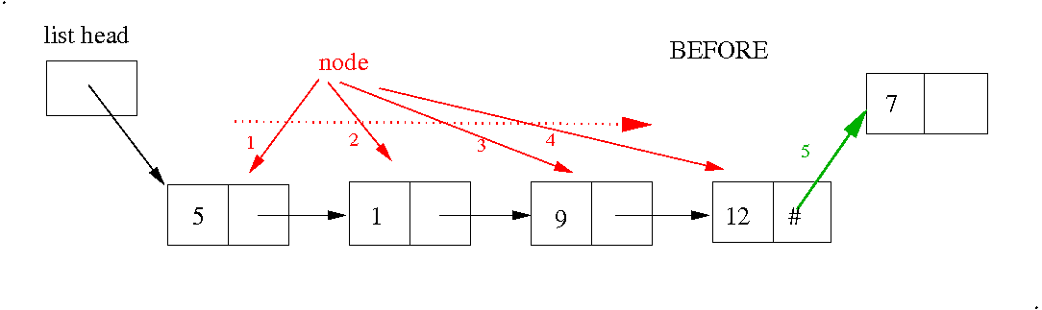
Insertion at End of List
first iterate to the end of the list (red)
then append the new node (green)

Slide 51
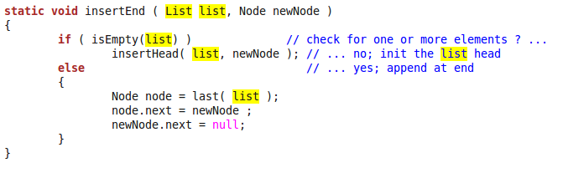
Insert at End of List
1) Treat empty list as special case

Slide 52
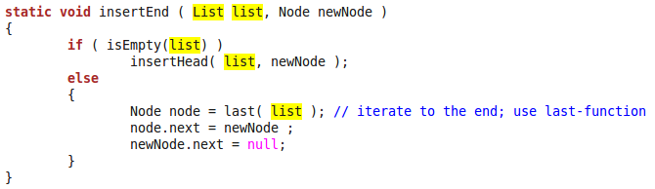
Insert at End of List
2) use previously defined “last”-function to find the end

Slide 53
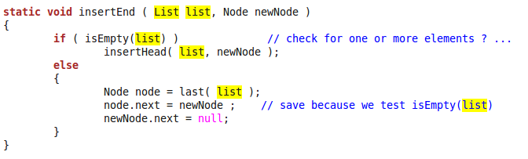
Insert at End of List
3) set the pointer
because we have checked that a node exists, we can access node.next without error (it will have the value null).

Slide 54
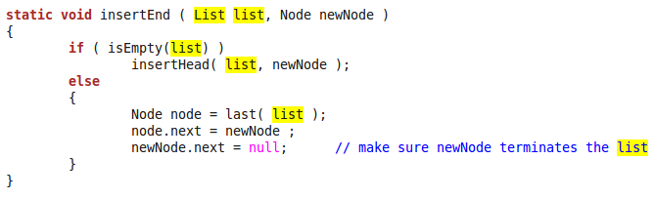
Insert at End of List
4) the final statement guarantees that the list is properly terminated (this may be omitted if newNode.next is always zero for new nodes)

Slide 55
Remove Element at End
We now need a reference to the second last node
We also need to consider zero or one nodes only

Slide 56
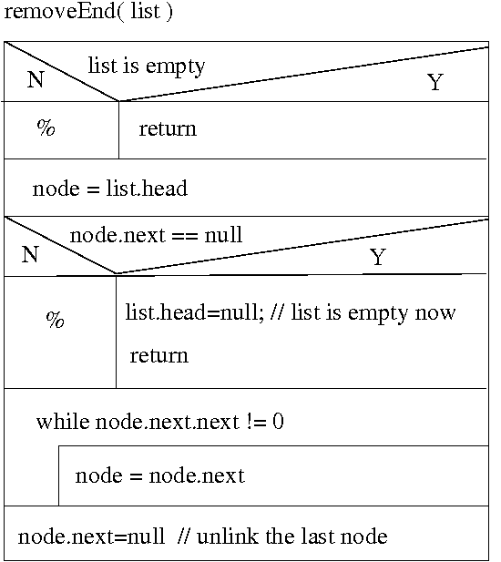
Remove Element at End
← empty list
← one item list
← find 2nd last item
← cut the last off

Slide 57
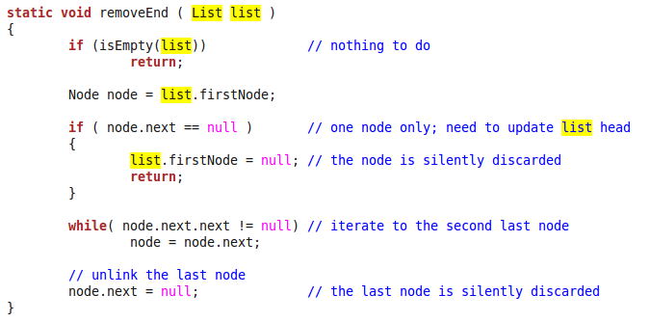
Remove Element at End
Note: The last element is not returned, just cut off

Slide 58
Insert/Delete Somewhere
→ Practicals

Slide 59
Stack and Queue as Linked Lists
Stack: Insert and remove at front only
(or alternatively at the end)
Queue: Insert at end; remove at front
(or the other way round)
Operations at the end can be made as efficient as at the front using a reference for the last item in the list class; this requires a little overhead

Slide 60
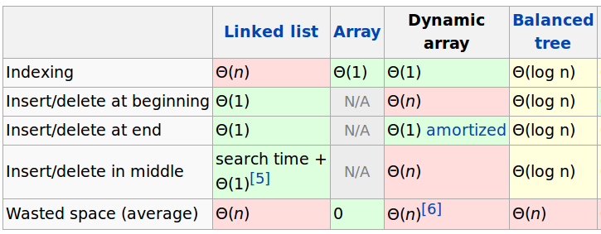
Complexity of Linked Lists and Arrays
Complexities for the doubly-linked list are the same
A dynamic array can increase at the end
Trees we do next week

Slide 61
Outcomes
Concept of a linked list as a basic dynamic data type
Queues and stacks implemented by linked lists
Idea of other linked data structures (later we will study trees and graphs)

